Slide 1
Not-so Famous Last Words
(Title Credit: King Kwong)
By: Sara Zeid

Slide 2
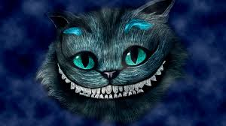
Biggest Lesson Learned
Stack Overflow can set you on your very own Alice in Wonderland Rabbit Hole Adventure
Useful function: enumerate()—Changed my life and project.
plt.tight_layout()
Import datetime
Index.get_duplicates()

Slide 3
Quick Facts
527 executed in Texas since 1982
419 statements
108 declined—About 20.5%
Texas has performed most executions and accounts for over 1/3rd executions in US(since reauthorization in 1976)
Supreme Court suspended capital punishment 1972 to 1976
Imposed unconstitutionally on grounds of “cruel and unusual punishment”
What is currently considered constitutional application? Defendant committed murder

Slide 4
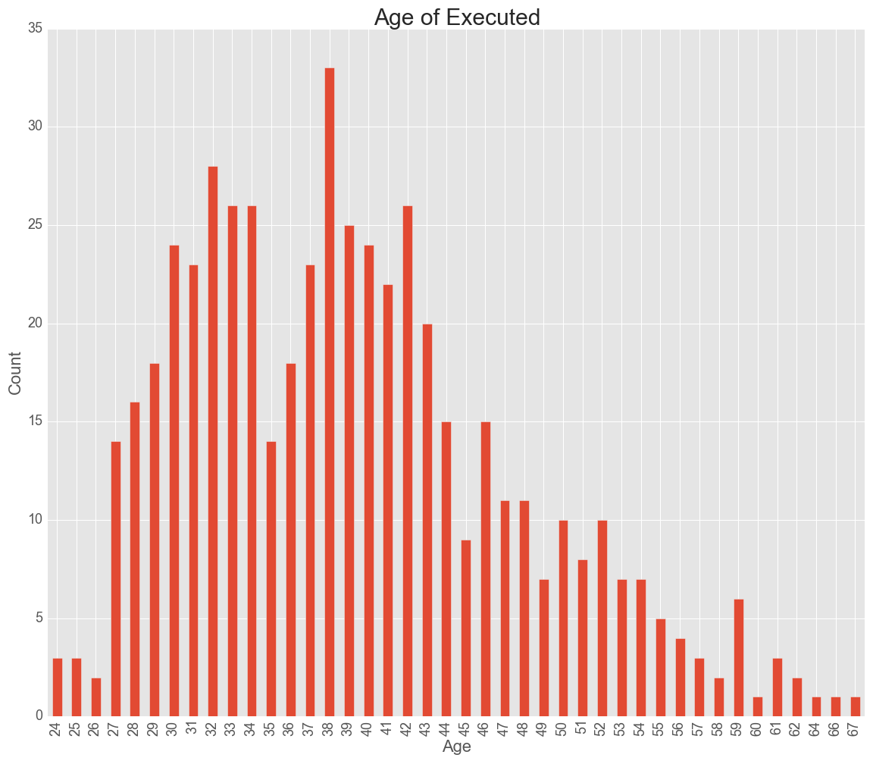
Average Age of Executed: 39
Youngest: 24
Oldest: 67
33 at age of 38

Slide 5
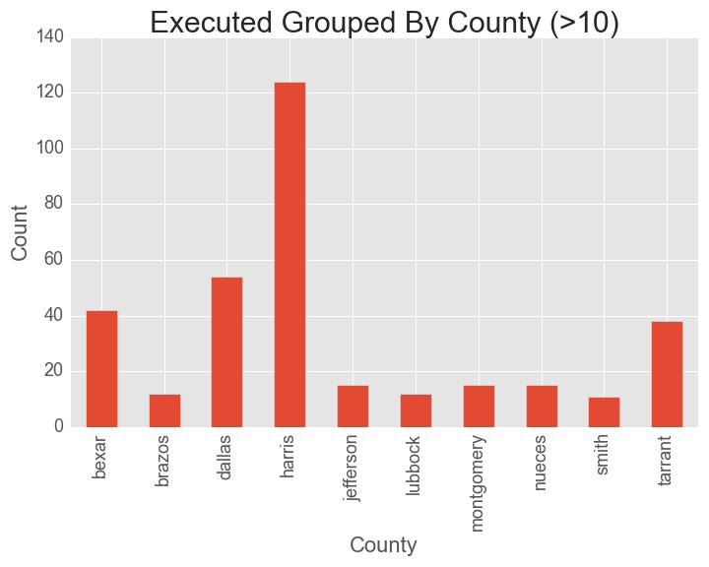
Harris County: Most populous in Texas

Slide 6
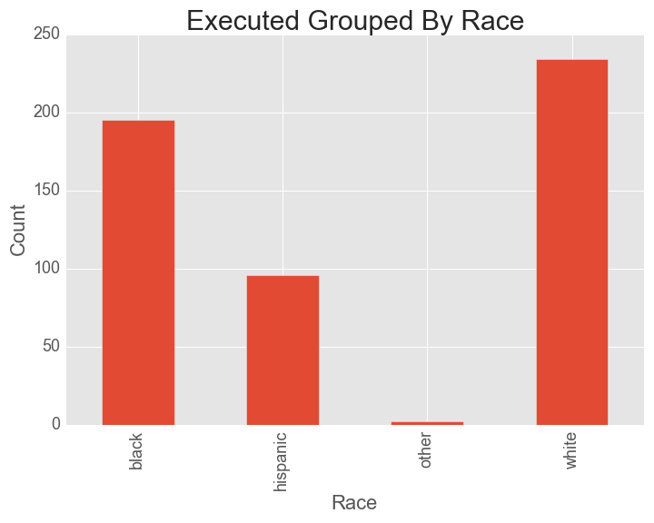

Slide 7
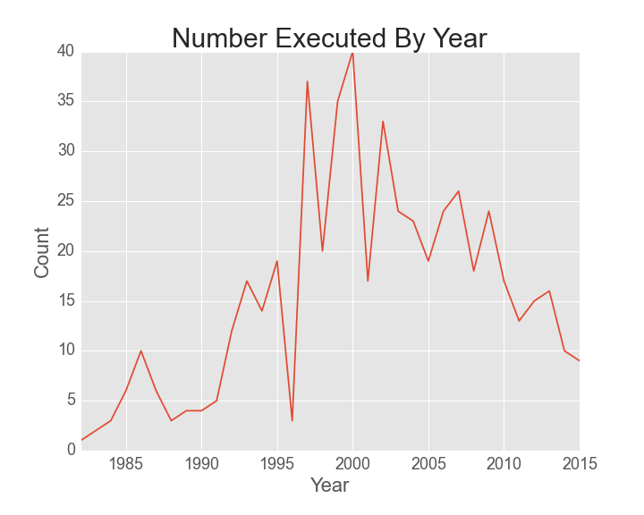
40 Executed in 2000

Slide 8
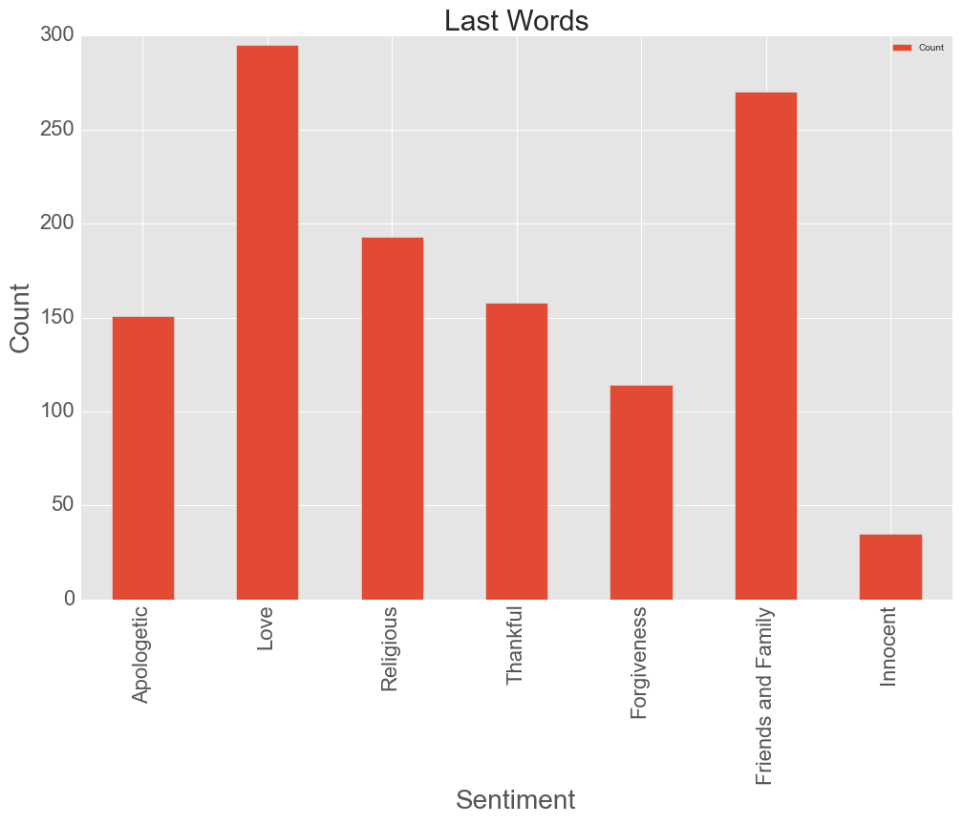

Slide 9
Longest Statement: Gary Graham, 39 (convicted at age of 18), 06/22/2000, Black, Wikipedia: Shaka Sankofa
In 2005, Supreme Court abolished executions for persons under the age of 18 at the time of the crime.
"I would like to say that I did not kill Bobby Lambert. That I'm an innocent black man that is being murdered. This is a lynching that is happening in America tonight. There's overwhelming and compelling evidence of my defense that has never been heard in any court of America. What is happening here is an outrage for any civilized country to anybody anywhere to look at what's happening here is wrong. I thank all of the people that have rallied to my cause. They've been standing in support of me. Who have finished with me. I say to Mr. Lambert's family, I did not kill Bobby Lambert. You are pursuing the execution of an innocent man. I want to express my sincere thanks to all of ya'll. We must continue to move forward and do everything we can to outlaw legal lynching in America. We must continue to stay strong all around the world, and people must come together to stop the systematic killing of poor and innocent black people. We must continue to stand together in unity and to demand a moratorium on all executions. We must not let this murder/lynching be forgotten tonight, my brothers. We must take it to the nation. We must keep our faith. We must go forward. We recognize that many leaders have died. Malcom X, Martin Luther King, and others who stood up for what was right. They stood up for what was just. We must, you must brothers, that's why I have called you today. You must carry on that condition. What is here is just a lynching that is taking place. But they're going to keep on lynching us for the next 100 years, if you do not carry on that tradition, and that period of resistance. We will prevail. We may loose this battle, but we will win the war. This death, this lynching will be avenged. It will be avenged, it must be avenged. The people must avenge this murder. So my brothers, all of ya'll stay strong, continue to move forward. Know that I love all of you. I love the people, I love all of you for your blessing, strength, for your courage, for your dignity, the way you have come here tonight, and the way you have protested and kept this nation together. Keep moving forward, my brothers. Slavery couldn't stop us. The lynching couldn't stop us in the south. This lynching will not stop us tonight. We will go forward. Our destiny in this country is freedom and liberation. We will gain our freedom and liberation by any means necessary. By any means necessary, we keep marching forward. I love you, Mr. Jackson. Bianca, make sure that the state does not get my body. Make sure that we get my name as Shaka Sankofa. My name is not Gary Graham. Make sure that it is properly presented on my grave. Shaka Sankofa. I died fighting for what I believe in. I died fighting for what was just and what was right. I did not kill Bobby Lambert, and the truth is going to come out. It will be brought out. I want you to take this thing off into international court, Mr. Robert Mohammed and all ya'll. I want you, I want to get my family and take this down to international court and file a law suit. Get all the video tapes of all the beatings. They have beat me up in the back. They have beat me up at the unit over there. Get all the video tapes supporting that law suit. And make the public exposed to the genocide and this brutality world, and let the world see what is really happening here behind closed doors. Let the world see the barbarity and injustice of what is really happening here. You must get those video tapes. You must make it exposed, this injustice, to the world. You must continue to demand a moratorium on all executions. We must move forward Minister Robert Mohammed. Ashanti Chimurenga, I love you for standing with me, my sister. You are a strong warrior queen. You will continue to be string in everything that you do. Believe in yourself, you must hold your head up, in the spirit of Winnie Mandela, in the spirit of Nelson Mandela. Ya'll must move forward. We will stop this lynching. Reverend Al Sharpton, I love you, my brother. Bianca Jagger, I love all of you. Ya'll make sure that we continue to stand together. Reverend Jesse Jackson and know that this murder, this lynching will not be forgotten. I love you, too, my brother. This is genocide in America. This is what happens to black men when they stand up and protest for what is right and just. We refuse to compromise, we refuse to surrender the dignity for what we know is right. But we will move on, we have been strong in the past. We will continue to be strong as a people. You can kill a revolutionary, but you cannot stop the revolution. The revolution will go on. The people will carry the revolution on. You are the people that must carry that revolutionary on, in order to liberate our children from this genocide and for what is happening here in America tonight. What has happened for the last 100 or so years in America. This is the part of the genocide, this is part of the African (unintelligible), that we as black people have endured in America. But we shall overcome, we will continue with this. We will continue, we will gain our freedom and liberation, by any means necessary. Stay strong. They cannot kill us. We will move forward. To my sons, to my daughters, all of you. I love all of you. You have been wonderful. Keep your heads up. Keep moving forward. Keep united. Maintain the love and unity in the community. And know that victory is assured. Victory for the people will be assured. We will gain our freedom and liberation in this country. We will gain it and we will do it by any means necessary. We will keep marching. March on black people. Keep your heads high. March on. All ya'll leaders. March on. Take your message to the people. Preach the moratorium for all executions. We're gonna stop, we are going to end the death penalty in this country. We are going to end it all across this world. Push forward people. And know that what ya'll are doing is right. What ya'll are doing is just. This is nothing more that pure and simple murder. This is what is happening tonight in America. Nothing more than state sanctioned murders, state sanctioned lynching, right here in America, and right here tonight. This is what is happening my brothers. Nothing less. They know I'm innocent. They've got the facts to prove it. They know I'm innocent. But they cannot acknowledge my innocence, because to do so would be to publicly admit their guilt. This is something these racist people will never do. We must remember brothers, this is what we're faced with. You must take this endeavor forward. You must stay strong. You must continue to hold your heads up, and to be there. And I love you, too, my brother. All of you who are standing with me in solidarity. We will prevail. We will keep marching. Keep marching black people, black power. Keep marching black people, black power. Keep marching black people. Keep marching black people. They are killing me tonight. They are murdering me tonight. "

